Slide 1
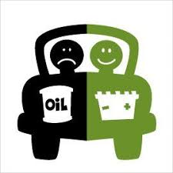
Unit 1:- Electric and Hybrid Powertrain Technologies
By:- Prof. Dr. Saket Yeolekar

Slide 2
Lecture 9
Power Train Tractive Effort
Vehicle Speed
Power Plant Characteristics
Gasoline engine Characteristics
Electric Motor Characteristics
Transmission Characteristics
Manual Gear Transmission Characteristics
Hydrodynamic Gear Transmission Characteristics
Vehicle Performance (Gasoline)
Vehicle Performance (Electric Motor)
Operating Fuel Economy
Fuel Economy of Internal Combustion Engines
Braking Performance

Slide 3

Power Train Tractive Effort ….
Power train, consists of a power plant (engine or electric motor), a clutch in manual transmission or a torque converter in automatic transmission, a gearbox (transmission), final drive, differential, drive shaft, and driven wheels.
The gearbox supplies a few gear ratios from its input shaft to its output shaft for the power plant torque–speed profile to match the requirements of the load.
The torque on the driven wheels, transmitted from the power plant, is expressed as
where ig is the gear ratio ig=Nin/Nout, ηt is the efficiency of the driveline, Tp is the torque output from the power plant

Slide 4
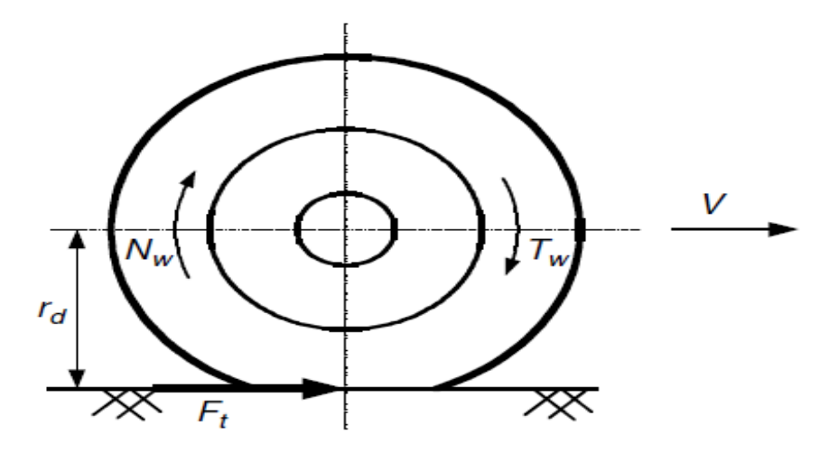


Power Train Tractive Effort and Vehicle Speed….
The tractive effort on the driven wheels
Mechanical efficiency of various components:
Clutch: 99%
Each pair of gears: 95–97%
Bearing and joint: 98–99%
Manual gear Efficiency :
Direct gear: 90%
Other gear: 85%
Transmission with a very high reduction ratio: 75–80%

Slide 5



Vehicle Speed….
The rotating speed (rpm) of the driven wheel can be expressed as
where Np is the output rotating speed (rpm). The translational speed of the wheel center (vehicle speed) can be expressed as
From above expressions vehicle speed can be expressed as
ig i0 are the gear ratio of transsmition to final drive, Np is the output rotating speed, rd is wheel radius.

Slide 6
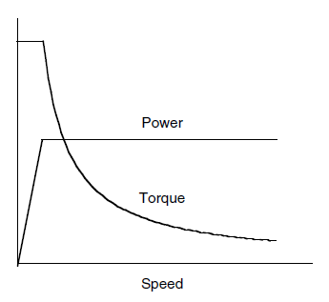
Power Plant Characteristics….
The ideal performance characteristic of a power plant is the constant power output over the full speed range.
Consequently, the torque varies with speed hyperbolically
At low speeds, the torque is constrained to be constant so as not to be over the maxima limited by the adhesion between the tire–ground contact area
Ideal performance characteristics for a vehicle traction power plant

Slide 7
Gasoline engine Characteristics….
Since the internal combustion engine and electric motor are the most commonly used power plants for automotive vehicles to date, it is appropriate to review the basic features of the characteristics that are essential to predicating vehicle performance and driveline design
The internal combustion engine usually has torque–speed characteristics far from the ideal performance characteristic required by traction.
It starts operating smoothly at idle speed. Good combustion quality and maximum engine torque are reached at an intermediate engine speed. As the speed increases further, the mean effective pressure decreases because of the growing losses in the air-induction manifold and a decline in engine torque.

Slide 8
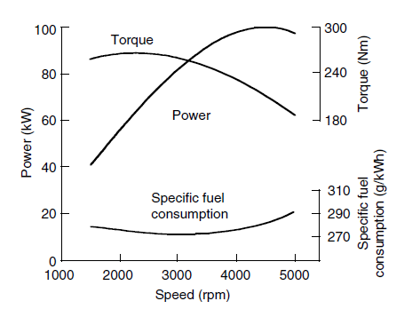
Gasoline Engine Characteristics….
Power output, however, increases to its maximum at a certain high speed. Beyond this point, the engine torque decreases more rapidly with increasing speed. This results in the decline of engine power output.
In vehicular applications, the maximum permissible speed of the engine is usually set just a little above the speed of the maximum power output.
Gasoline engine in full throttle
The internal combustion engine has a relatively flat torque–speed profile (compared with an ideal one),

Slide 9
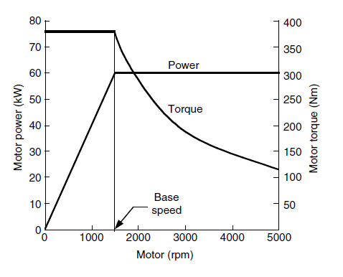
Electric motors Characteristics….
Electric motors, usually have a speed–torque characteristic that is much closer to the ideal characteristics
Generally, the electric motor starts from zero speed. As it increases to its base speed, the voltage increases to its rated value while the flux remains constant.
Electric traction motors (full load)

Slide 10
Electric motors Characteristics….
Beyond the base speed, the voltage remains constant and the flux is weakened. This results in constant output power while the torque declines hyperbolically with speed.
Since the speed–torque profile of an electric motor is close to the ideal, a single-gear or double-gear transmission is usually employed
Electric traction motors (full load)

Slide 11
Transmission Characteristics….
The transmission requirements of a vehicle depend on the characteristics of the power plant and the performance requirements of the vehicle.
Well-controlled electric machine such as the power plant of an electric vehicle will not need a multi-gear transmission
However, an internal combustion engine must have a multi-gear or continuously varying transmission to multiply its torque at low speed.
There are usually two basic types of transmission:
  Manual gear transmission
  Hydrodynamic transmission

Slide 12
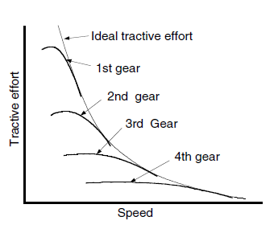

Manual Gear Transmission Characteristics….
The maximum speed requirement of the vehicle determines the gear ratio of the highest gear (i.e., the smallest ratio)
The gear ratio of the lowest gear (i.e., the maximum ratio) is determined by the requirement of the maximum tractive effort
The following relationship can be established in gear ratios

Slide 13
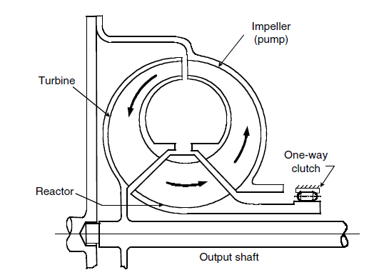
Hydrodynamic Gear Transmission Characteristics….
Hydrodynamic transmissions use fluid to transmit power in the form of torque and speed and are widely used in passenger cars
They consist of a torque converter and an automatic gearbox. The torque converter consists of at least three rotary elements known as the impeller (pump), the turbine, and the reactor
Schematic view of a torque converter
The impeller is connected to the engine shaft and the turbine is connected to the output shaft of the converter, which in turn is coupled to the input shaft of the multispeed gearbox.

Slide 14
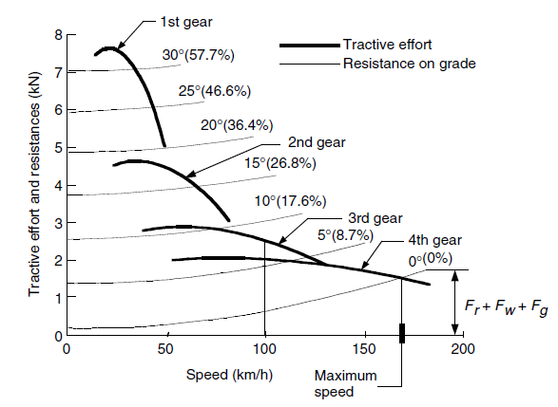
Vehicle Performance (Gasoline) ….
The performance of a vehicle is usually described by its maximum cruising speed, gradeability, and acceleration.
The predication of vehicle performance is based on the relationship between tractive effort and vehicle speed
It is assumed that the maximum tractive effort is limited by the maximum torque of the power plant rather than the road adhesion capability
Gasoline engine-powered vehicle with multispeed transmission and its resistance

Slide 15
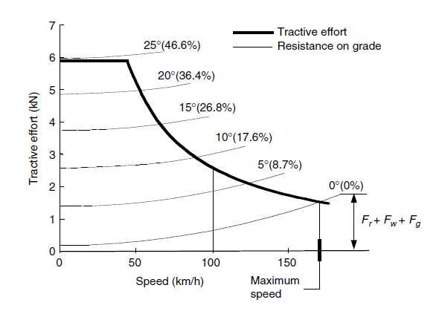
Vehicle Performance….
Electric motor-powered vehicle with single-speed transmission and its resistance

Slide 16
Operating Fuel Economy….
The fuel economy of a vehicle is evaluated by the amount of fuel consumption per 100 km traveling distance (liters/100 km)
or mileage per gallon fuel consumption (miles/gallon), which is currently used in the U.S.
The operating fuel economy of a vehicle depends on a number of factors, including fuel consumption characteristics of the engine, gear number and ratios, vehicle resistance, vehicle speed, and operating conditions

Slide 17
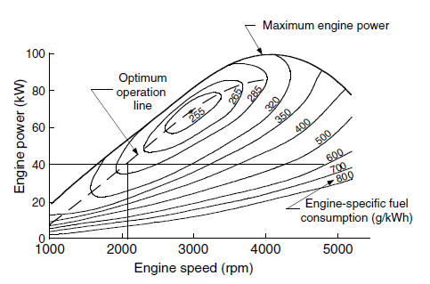
Fuel Economy of Internal Combustion Engines….
The fuel consumption is quite different from one operating point to another. The optimum operating points are close to the points of full load (wide-opened throttle)
The speed of the engine also has a significant influence on fuel economy.
power output of 40 kW, its minimum specific fuel consumption would be 270 g/kWh at a speed of 2080 rpm

Slide 18
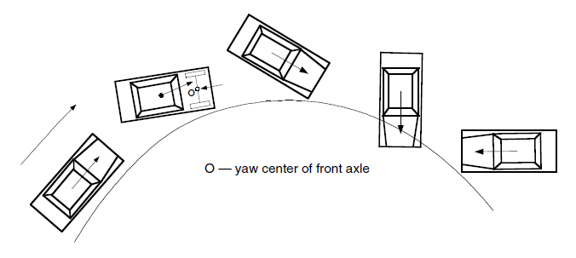
Braking Performance….
The braking performance of a vehicle is undoubtedly one of the most important characteristics that affect vehicle safety
A well-designed regenerative braking system not only improves vehicle efficiency but also potentially improves braking performance. It can be Braking Force can be improved by Braking Distribution on Front and Rear Axles
Loss of directional stability due to the lockup of rear wheels

